Slide 1

“i feel happy because have the support of my friends and family, there are hard days and good days“
Objectives
Master well the other limbs that can move
Finish her studies and fun occasionally
Frustrations
Although it does not commonly hurt, her health problem has no cure
There are computer commands that tipically require 2 hands
Ann Isaya

Slide 2
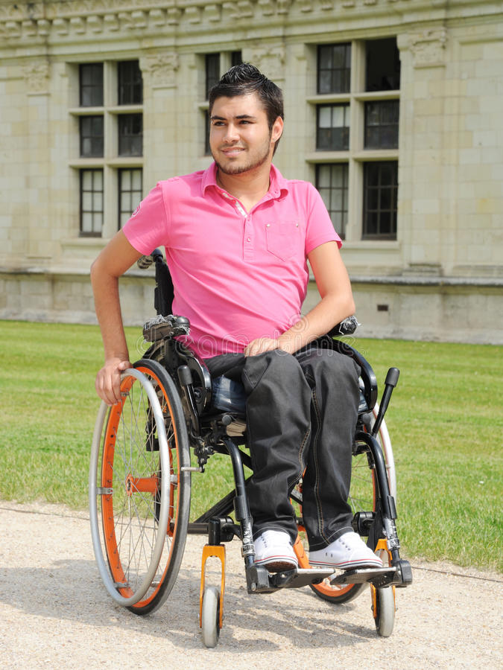
“Everyday is painful but that don’t stop me, the health is the most important that we have"
Objectives
Have a service that help him to take care of itself without neglecting him business
Using the wheelchair less and less
Frustrations
If him look for ways to feel better will inevitably neglect the business
Although he has the possibility of having surgery, it is too expensive for him
Jeral Hans

Slide 3
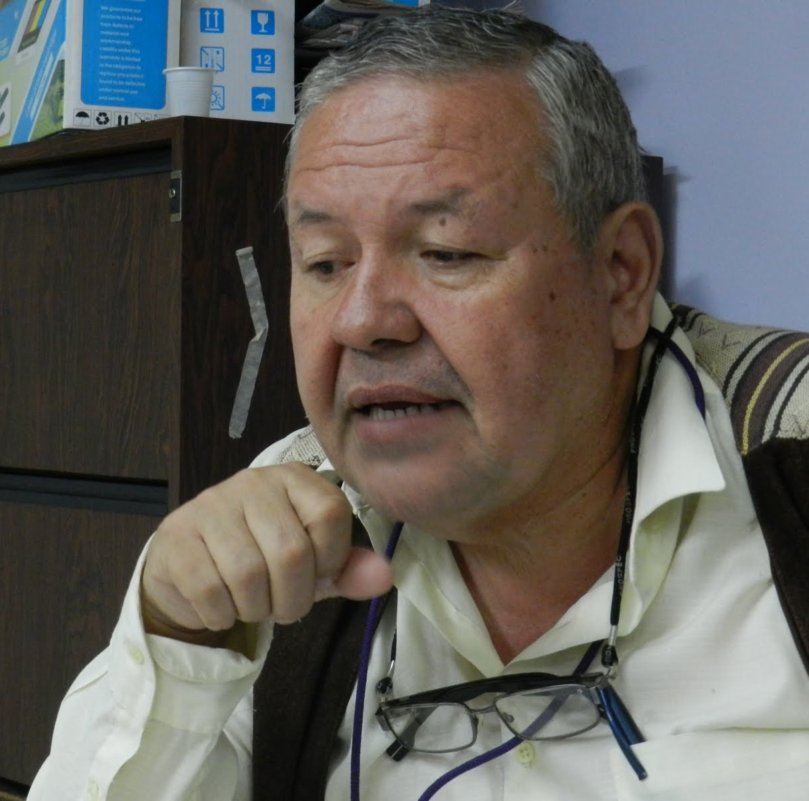
“Don’t let to tomorrow that you can do today, i still have so many to learn"
Objectives
Know an approximated automovilistic diagnostic through the web that support him to request to customers
Frustrations
Lack of expertise at the web
Low knowledge about the automobile parts
Cristobal Marcos

Slide 4
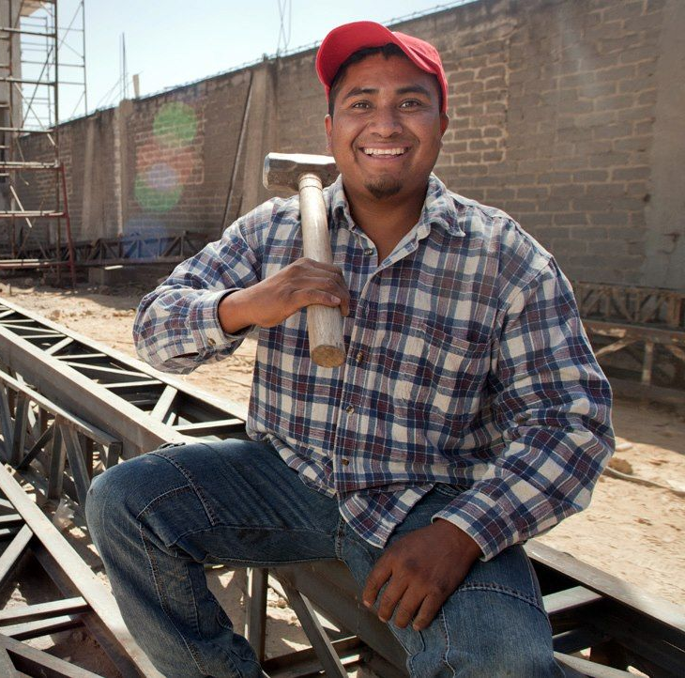
“Everyday lived is as write a new page of a story, the people changes and the times also"
Objectives
Enjoy with Friends on a lively place
Visualize online a catalog of promotions
Frustrations
Customer service is slow
There are times where there is so many people or the music is very high
Eleuterio Flores

Slide 5

“I have great expectations and aspirations to future, i have no doubt that there is a whole life waiting for me"
Objectives
Tener mayor protección adentro del lugar
Salir de la rutina junto a su pareja de vez en cuando
Frustrations
Ver menores de edad bebiendo y mucho descontrol adentro de la cervecería
No poder tomarse su propio tiempo para pedir ya que es indecisa
Christine Álvarez

Slide 6
HOME
BLOGS
AILMENTS HISTORIES
GENERAL TIPS
NUTRITIONAL ASESORIES
NUTRITIONAL PLANS
ACCOUNT
EDIT
DELETE
SAUCERS

Slide 7
Start
Automobile selection
Results
Possible solutions
Diagnostic
Start process
Approximated diagnostic
Diagnostic questions
Ability to describe the problem
Brand choice
Model
Date of creation
Info about us to inspire confident
Possible problems

Slide 8
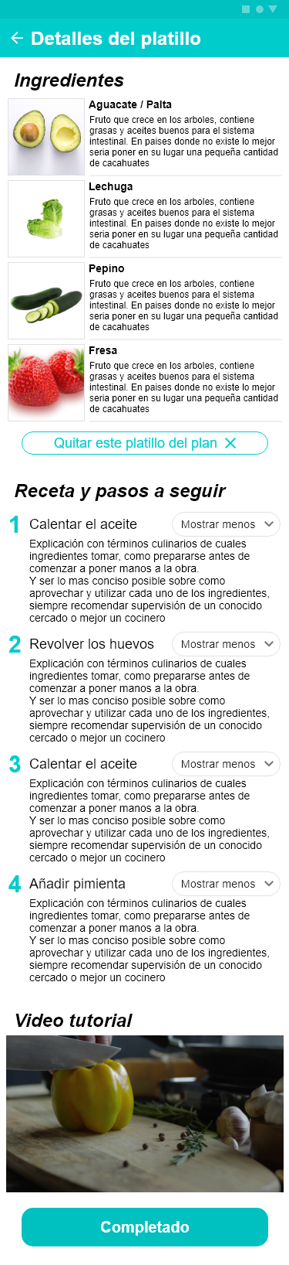
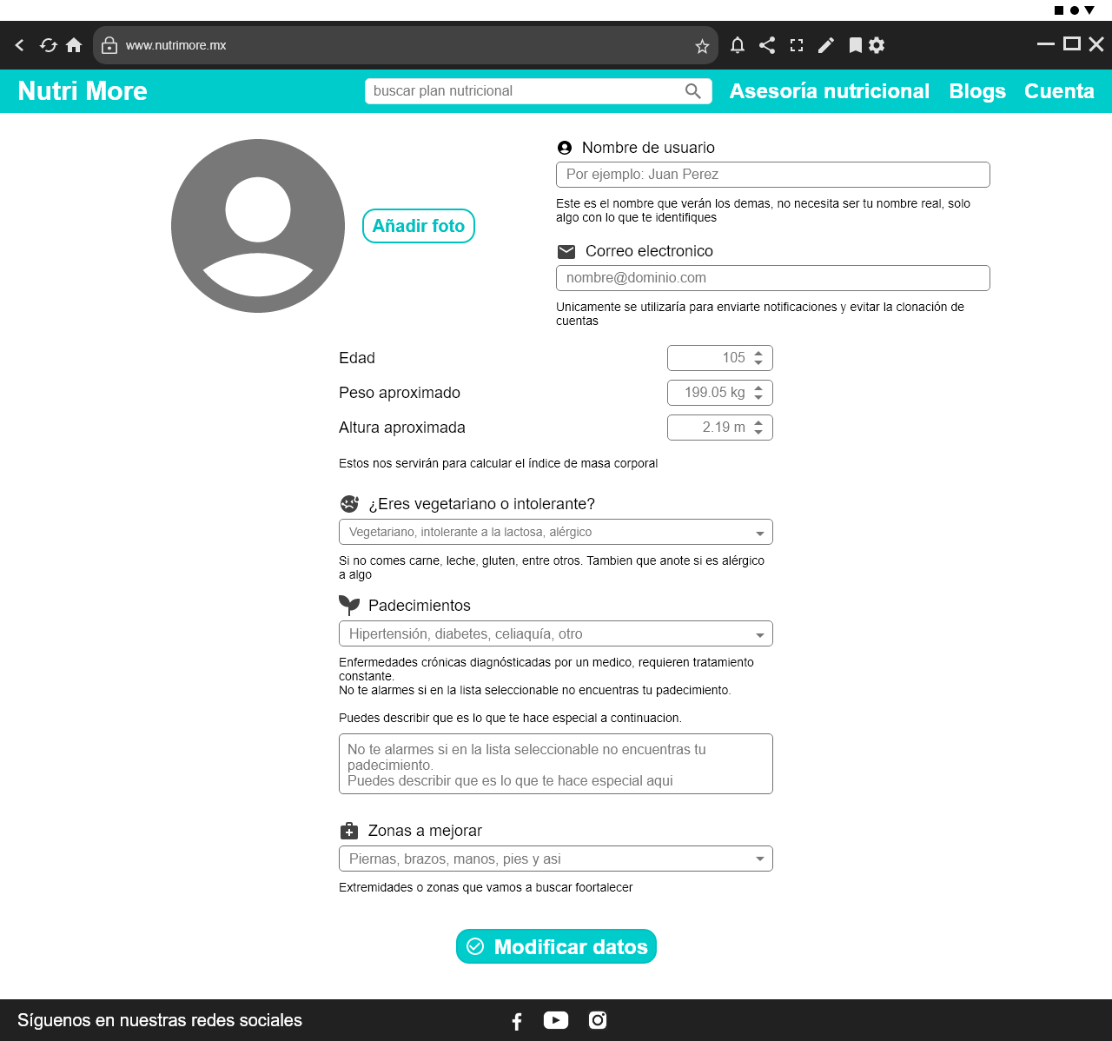
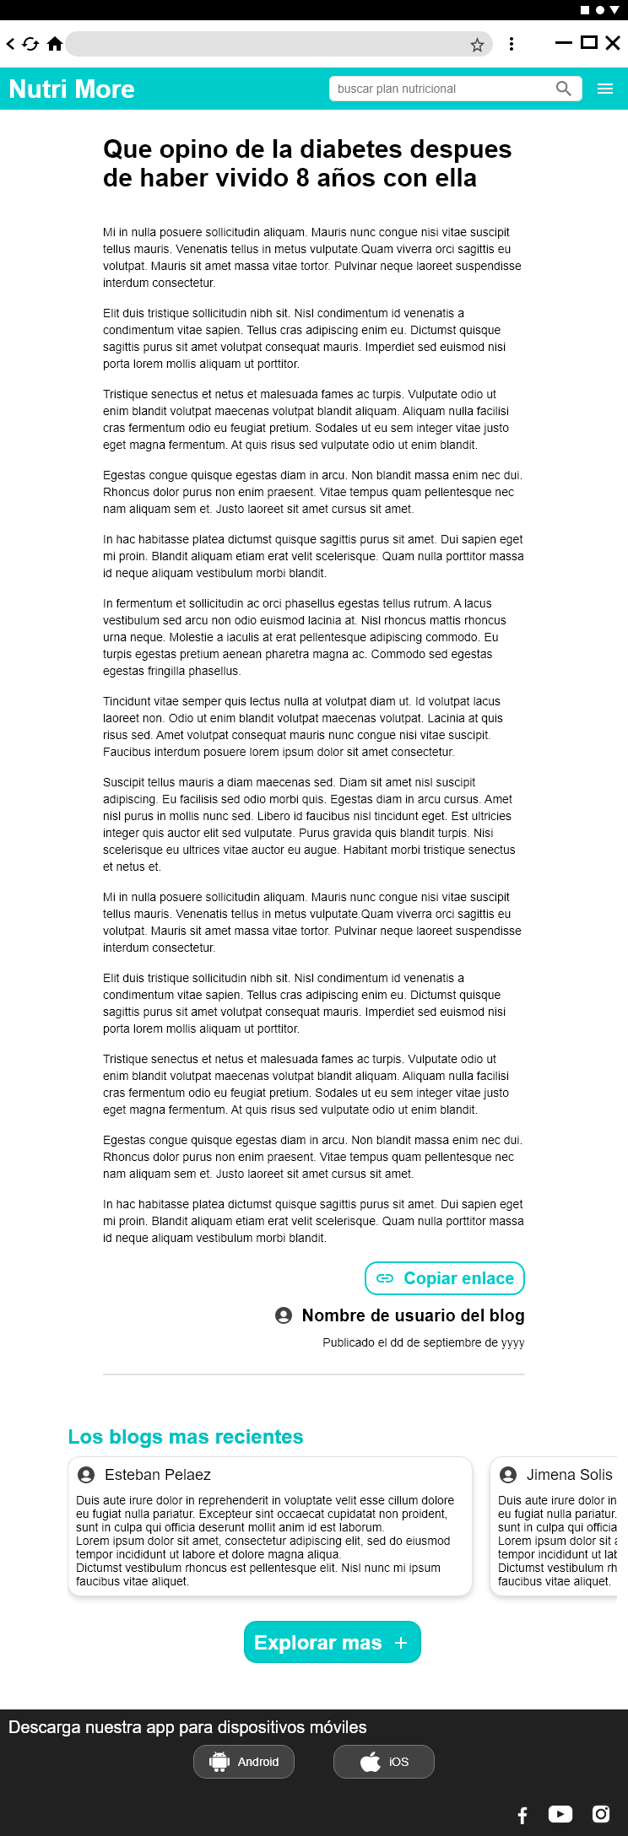
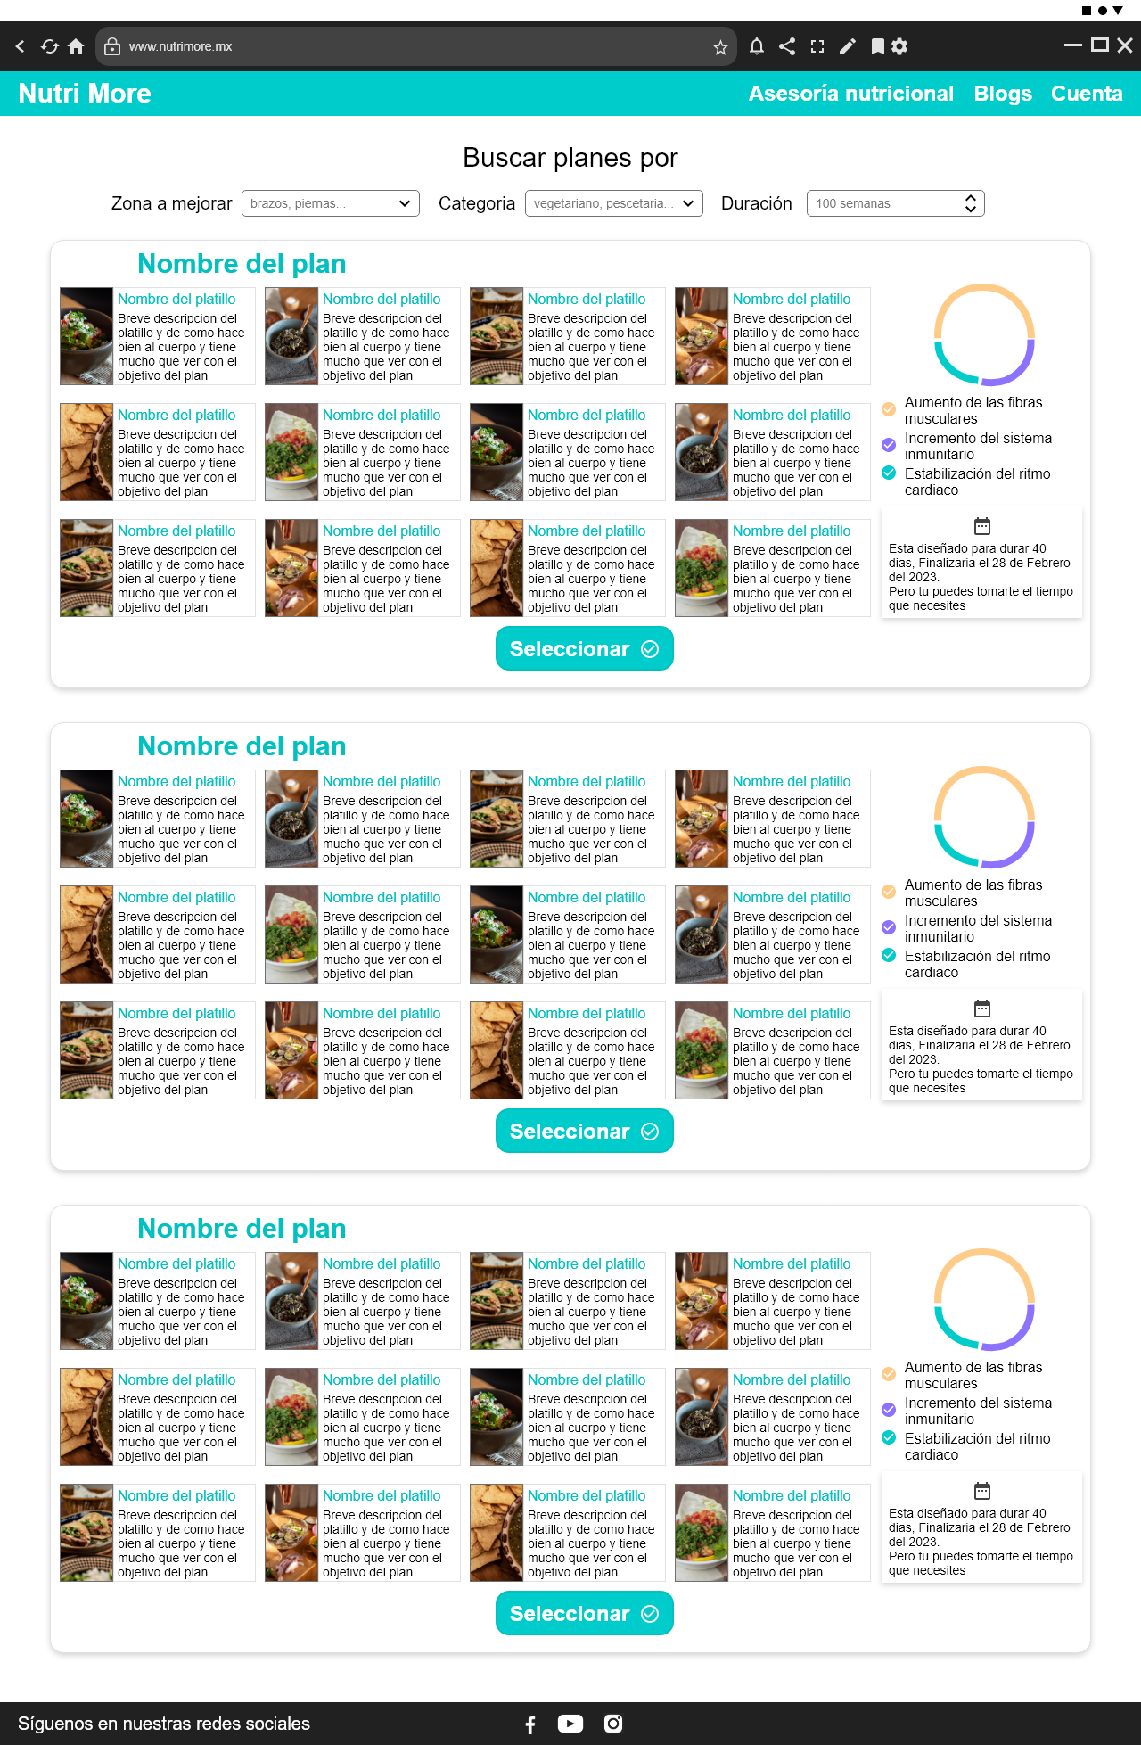
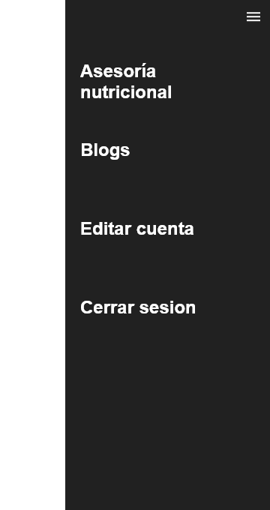
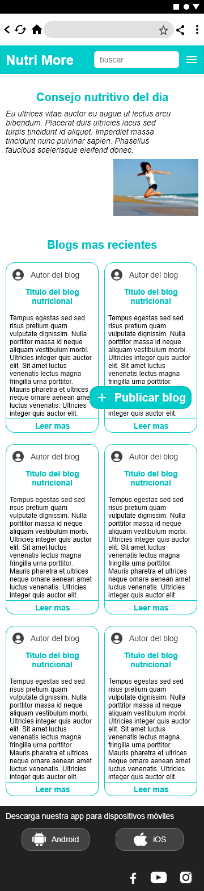
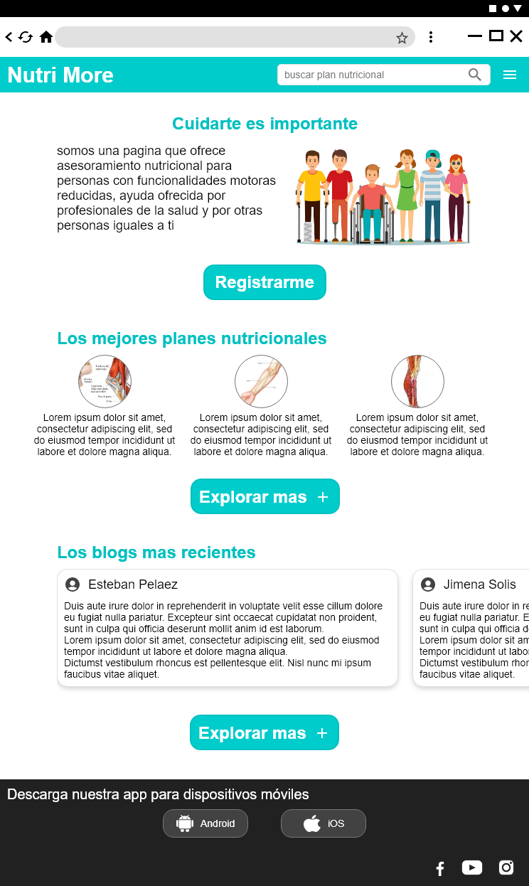

Slide 9
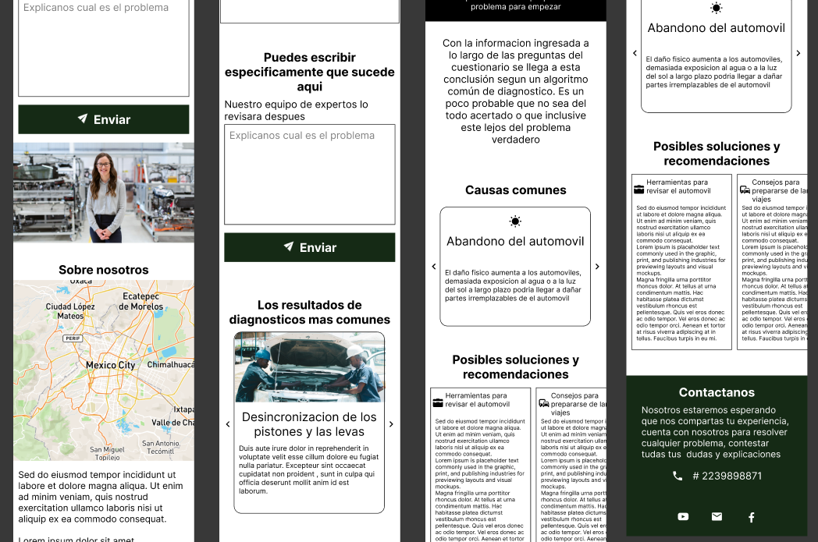
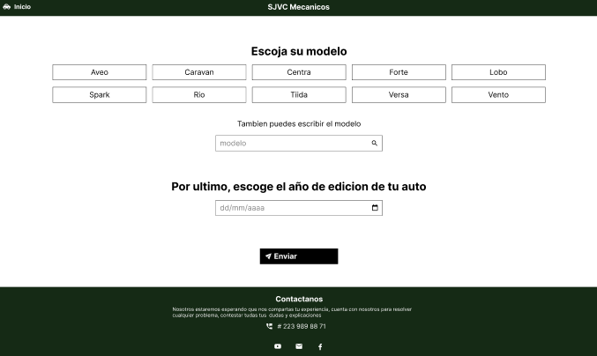
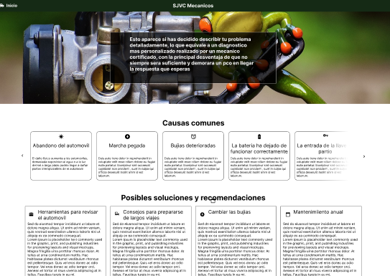
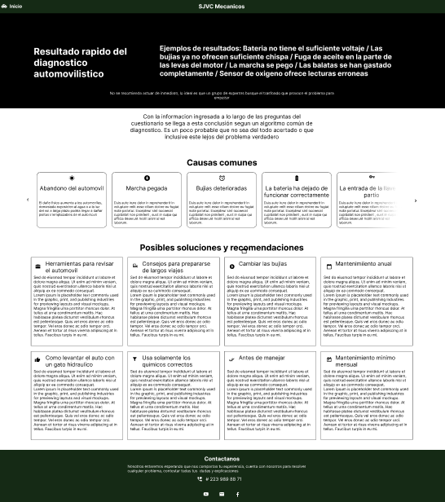
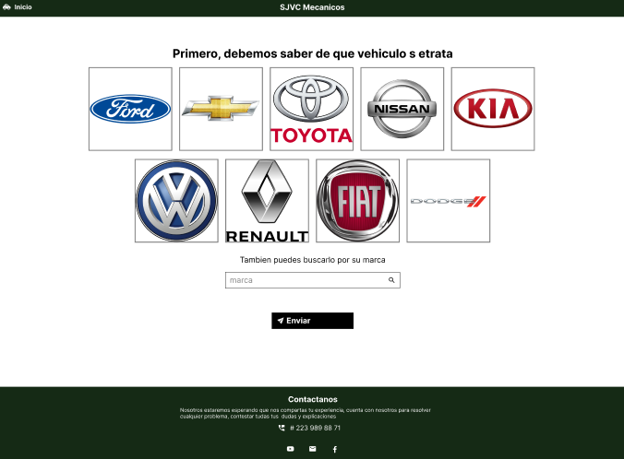
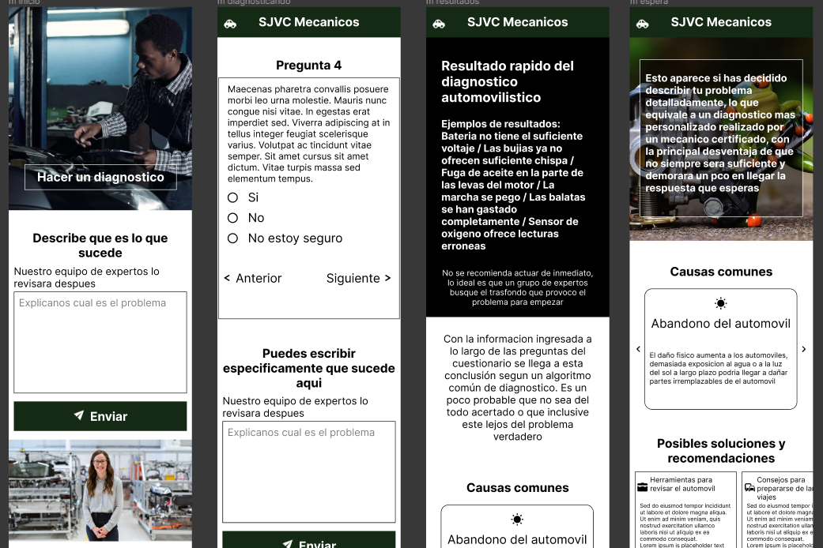

Slide 10
ACTION | PLANNING | GET TO THE BEER SHOP | ORDERING | GO BACK TO HOME
TASK LIST | A. Buscar o preguntar por promociones B. Invitar amigos C. Dejar todo listo en casa incluyendo al perro | A. Prepararse antes de salir B. Encontrar un lugar alejado de las bocinas C. Esperar al menos 1 de sus amigos | A. Confirmar si vale la promoción que encontró anteriormente B. Pasar el rato | A. Pagar entre todos la cuenta B. Despedirse C. Ir a casa
FEELING ADJECTIVE | - Desorientado al no hallar lo que busca - Ansioso - Prisas por llegar | - Precaución por olvidar algo - Decepción | - Defraudado si no lo atienden bien - Feliz y en paz | - Confundido por los numeros - Satisfecho
OPPORTUNITIES | - Ofrecer un catalogo online - Promocionar con redes sociales | - Poner mas mesas - No subir mucho el volumen de la musica | - Tener actualizado el catalogo | - Ser atentos y ayudarlos a dividir el precio

Slide 11
Order this item?
Select an item
Watch item details
N
Y
Watch the menu
Confirm before the buy
Paid confirmation screen
Open app
Accept the item purchase
Configuration sceen
N
Y
Is paid?
Watch pay screen

